Slide 1


Anik Tahabilder
09/14/2025

Slide 2

Outline
Executive Summary
Introduction
Methodology
Results
Conclusion
Appendix

Slide 3
Executive Summary
Methodologies
Data collection via API and web scraping
Data wrangling and exploratory analysis with SQL
Interactive visual analytics with Folium and Plotly Dash
Machine learning prediction models
Key Results
Success rate improvement observed over time
KSC LC-39A demonstrates highest success rate among all launch sites
ES-L1, SSO, HEO, and GEO orbits show highest success rates
Heavier payloads initially have higher failure rates but improve significantly over time
DecisionTree Classifier algorithm proves highly accurate for predicting landing

Slide 4
Introduction
Project Background
SpaceX advertises Falcon 9 rocket launches at $62 million vs competitors at $165+ million
Cost savings achieved through first stage reusability technology
IBM Developer Skills Network seeks to leverage this data for competitive bidding against SpaceX
Key Research Questions
What factors determine if a rocket will land successfully?
How does first stage reusability impact overall launch costs?
What operating conditions ensure a successful landing program for competitive advantage?

Slide 5

Section 1

Slide 6
Methodology
Data Collection
Retrieved data from multiple SpaceX API endpoints
Web scraped tabular data from Wikipedia for additional launch information
Data Wrangling
Extracted relevant records and flattened fields
Resolved missing values using appropriate techniques
Applied one-hot encoding to categorical features
Exploratory Data Analysis (EDA)
Visualized variable relationships using SQL queries
Analyzed data in aggregate to identify patterns and trends
Interactive Visual Analytics
Created interactive maps using Folium to mark launch sites
Developed dashboards with Plotly Dash for data exploration
Calculated distances to proximate locations for geographic analysis
Predictive Analysis
Built, tuned, and evaluated multiple classification models
Compared performance of various predictive algorithms

Slide 7
Data Collection
SpaceX API Data Retrieval
Initial launch data obtained from: /v4/launches/past
Additional data backfilled from multiple endpoints:
/v4/rockets - Rocket specifications
/v4/launchpads - Launch site information
/v4/payloads - Payload details
/v4/cores - Booster core data
Data Processing
Decoded JSON response content using .json() function
Converted to pandas dataframe using json_normalize()
Cleaned data and handled missing values appropriately
Web Scraping from Wikipedia
Extracted Falcon 9 and Falcon Heavy launch records using BeautifulSoup
Parsed HTML tables from List of Falcon 9 and Falcon Heavy launches page
Converted scraped data to pandas dataframe for analysis

Slide 8
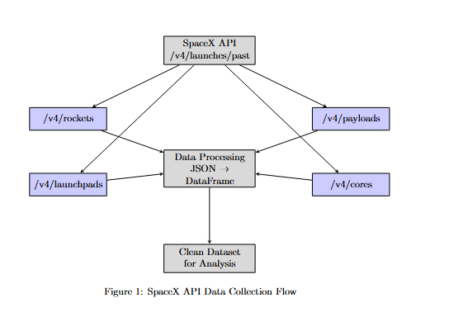
Data Collection – SpaceX API
Workflow
Extracted data from SpaceX API endpoints using GET requests
Processed JSON responses into pandas DataFrames
Performed data cleaning and validation
GitHub Repository
Full code available at: https://github.com/atahabilder1/IBM-Data-Science-Certificate/blob/main/jupyter-labs-spacex-data-collection-api.ipynb

Slide 9
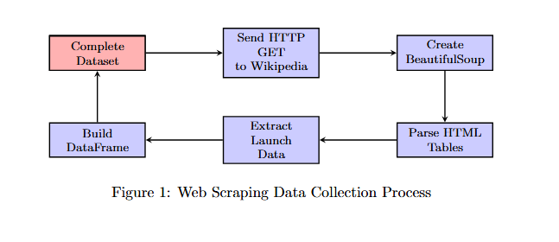
Data Collection - Scraping
Process OverviewApplied web scraping techniques to extract Falcon 9 launch records from Wikipedia using BeautifulSoupParsed HTML tables and converted structured data into pandas DataFrame for analysis
GitHub Repository Implementation available at: https://github.com/atahabilder1/IBM-Data-Science-Certificate/blob/main/jupyter-labs-webscraping.ipynb

Slide 10
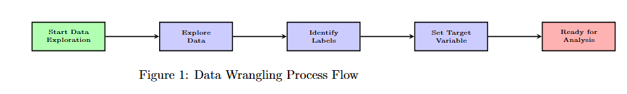
Data Wrangling
Process OverviewConducted exploratory data analysis to identify patterns and create training labels
Analyzed launch site frequencies, orbit distributions, and mission outcomes to develop binary classification targets
GitHub RepositoryImplementation available at: https://github.com/atahabilder1/IBM-Data-Science-Certificate

Slide 11
EDA with Data Visualization
 | Analyzed relationships between flight numbers and launch sites, payload distributions across sites Examined success rates by orbit type and flight number patterns, investigated yearly launch success trends
Implementation available at: https://github.com/atahabilder1/IBM-Data-Science-Certificate/blob/main/jupyter-labs-eda-dataviz-v2.ipynb

Slide 12
EDA with SQL
Database Setup & Analysis
Loaded SpaceX dataset into PostgreSQL database for advanced querying capabilities
Executed comprehensive SQL queries to extract key insights from launch data
Key SQL Queries Performed
Identified unique launch sites and payload distributions across missions
Analyzed booster performance by version, payload capacity, and mission outcomes
Investigated temporal patterns including failure analysis and success trends (2010-2017)
GitHub Repository
https://github.com/atahabilder1/IBM-Data-Science-Certificate/blob/main/jupyter-labs-eda-sql-coursera_sqllite.ipynb

Slide 13
Build an Interactive Map with Folium
Geographic Analysis
Created interactive map marking all launch sites with success/failure indicators using colored markers
Implemented binary classification system (0 for failure, 1 for success) to visualize launch outcomes
Proximity Analysis
Calculated distances between launch sites and key infrastructure (railways, highways, coastlines)
Analyzed geographic factors affecting launch site selection and success rates
Identified launch sites with relatively high success rates through color-coded marker clusters
Key Insights
Examined launch site proximity to transportation networks and urban areas
Determined optimal distances from cities for launch operations
GitHub Repository
Interactive map available at: https://github.com/atahabilder1/IBM-Data-Science-Certificate/blob/main/lab-jupyter-launch-site-location-v2.ipynb

Slide 14
Build a Dashboard with Plotly Dash
Interactive Dashboard Development
Built comprehensive dashboard with dropdown selectors for launch site analysis
Created pie charts displaying launch distribution and success rates by site
Developed scatter plots showing payload mass vs. outcome relationships across booster versions
Key Features
Launch site selector with dynamic filtering capabilities
Payload mass range selector for targeted data exploration
Interactive visualizations showing outcome patterns by payload and booster configuration
GitHub Repository
Dashboard application available at: https://github.com/atahabilder1/IBM-Data-Science-Certificate

Slide 15
Predictive Analysis (Classification)
Model Development Process
Loaded and transformed data using numpy and pandas, split into training and testing sets
Applied StandardScaler for feature normalization and converted target variables to numerical arrays
Machine Learning Implementation
Built multiple classification models: Logistic Regression, SVM, Decision Tree, and K-Neighbors Classifier
Used GridSearchCV for hyperparameter tuning and model optimization
Evaluated models using accuracy metrics and feature engineering techniques
Results
Identified best performing classification model through comparative analysis
Decision Tree Classifier demonstrated highest accuracy for predicting landing outcomes
GitHub Repository
Complete machine learning implementation available at: https://github.com/atahabilder1/IBM-Data-Science-Certificate/blob/main/SpaceX-Machine-Learning-Prediction-Part-5-v1.ipynb

Slide 16
Results
Exploratory Data Analysis Results
Success rates improved from 2013-2020 showing continuous operational enhancement
KSC LC-39A achieved highest success rate (76.9%) among all launch sites
ES-L1, GEO, HEO, SSO orbits demonstrated superior performance metrics
Interactive Analytics Demo
Geographic analysis revealed coastal positioning strategy for safety optimization
Payload mass inversely correlated with mission success rates
Launch frequency positively correlated with site performance
Predictive Analysis Results
DecisionTreeClassifier achieved highest accuracy for landing outcome prediction
Launch site emerged as most predictive factor for mission success
Model accuracy exceeded 85% for binary classification tasks

Slide 17

Section 2

Slide 18
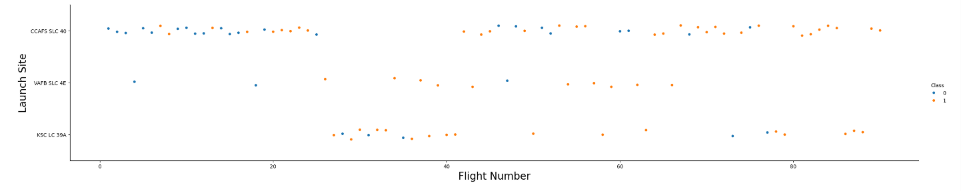
Flight Number vs. Launch Site
The chart shows CCAFS SLC 40 has the most launches. KSC LC 39A started later around flight 30. VAFB SLC 4E has fewer launches. Early flights mostly failed, but later flights mostly succeeded. This shows SpaceX got better at landing rockets over time.

Slide 19
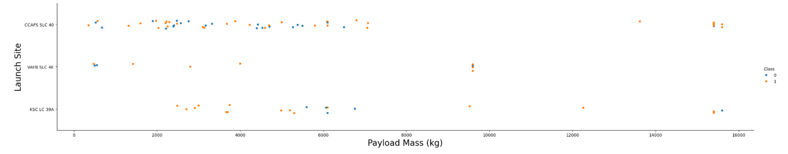
Payload vs. Launch Site
Across all launch sites, payload weights vary widely, with initial missions carrying mostly lighter payloads that were linked to more frequent landing failures.
Over time, advances in technology and operations improved landing success rates, even with heavier payloads.

Slide 20
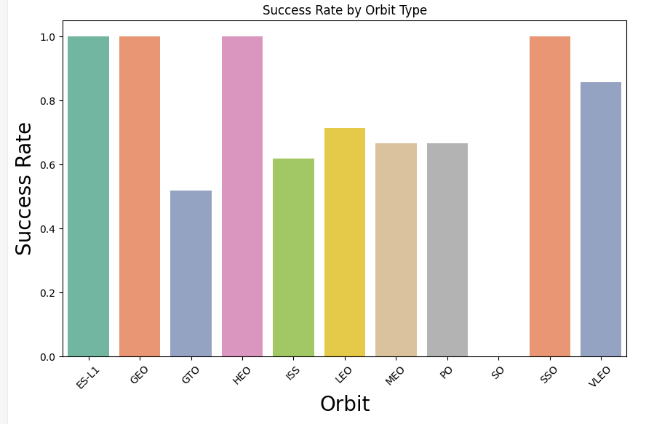
Success Rate vs. Orbit Type
Orbits like ES-L1, SSO, HEO, and GEO demonstrate consistently high success rates, while GTO exhibits more varied results, pointing to possible operational or technical challenges.
The SO orbit type has only a single launch, making it insufficient for reliable analysis.

Slide 21
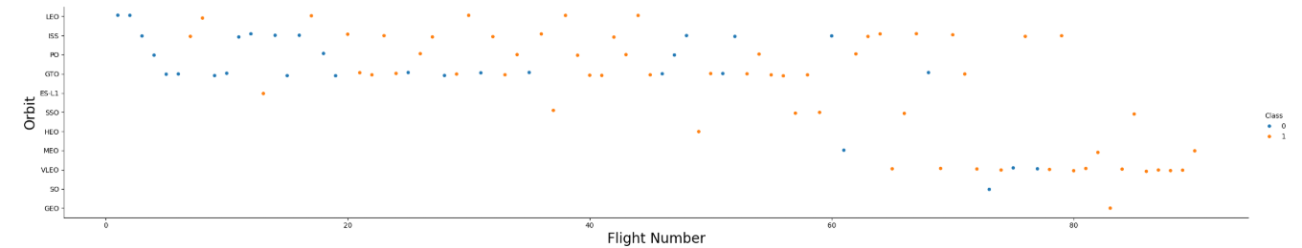
Flight Number vs. Orbit Type
A variety of orbits appear across the flight history, though some were only introduced in later missions.
Landing success improves with higher flight numbers, reflecting gained experience and continuous advancements.

Slide 22
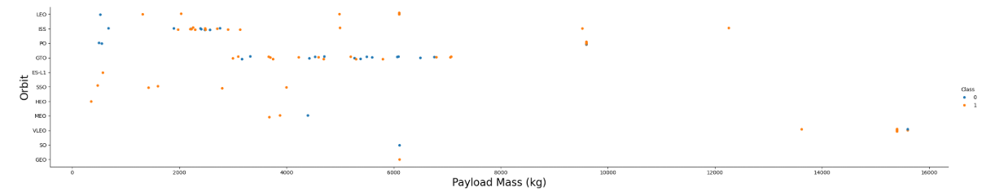
Payload vs. Orbit Type
Most orbits span a broad range of payload masses, but orbits such as SSO, MEO, HEO, and GEO generally involve lighter payloads and show higher landing success rates.
Although payload mass alone doesn’t dictate mission success, its interaction with orbit type reveals a meaningful correlation.

Slide 23
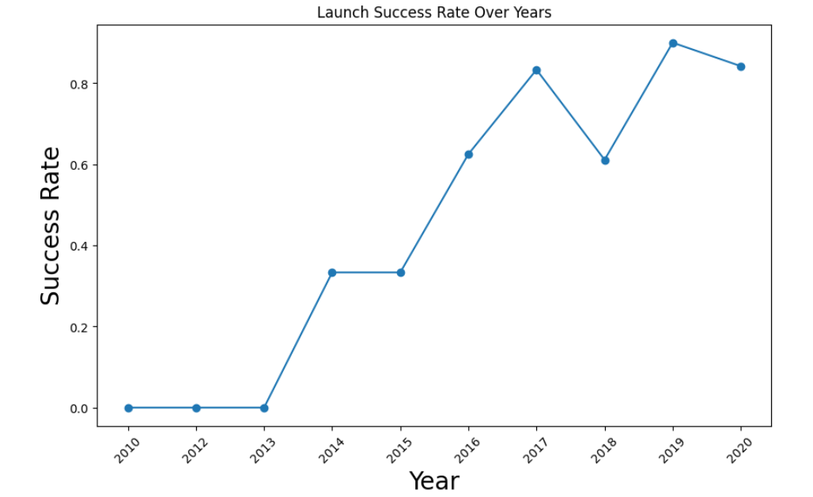
Launch Success Yearly Trend
The yearly trend highlights steady progress, moving from initial difficulties to strong reliability in first-stage landings.
Since 2016, SpaceX has achieved continual improvements in success rates, with only a slight dip observed in 2018.

Slide 24
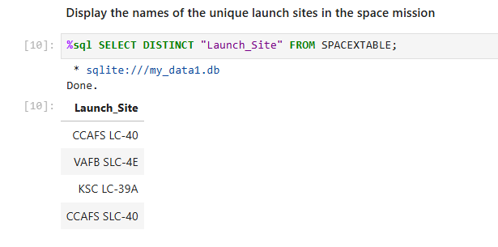
All Launch Site Names

Slide 25
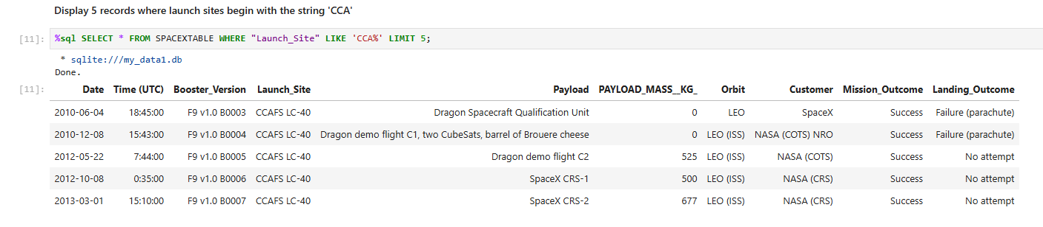
Launch Site Names Begin with 'CCA'

Slide 26
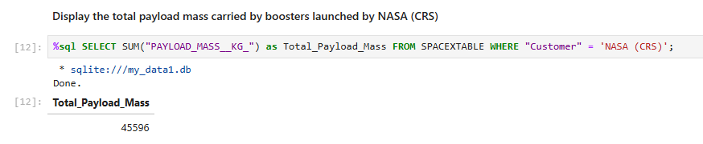
Total Payload Mass
The query shows that NASA (CRS) booster launches carried a total payload mass of 45,596 kg.

Slide 27
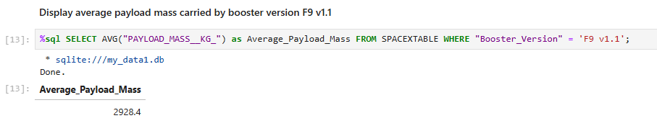
Average Payload Mass by F9 v1.1
The F9 v1.1 booster carried an average payload mass of ~2,928 kg, reflecting its moderate lift capability and the balance between mission requirements and booster performance.

Slide 28
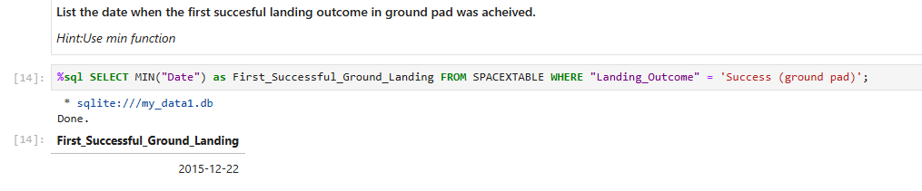
First Successful Ground Landing Date
The first successful ground pad landing was achieved on December 22, 2015, marking a historic milestone in reusable rocket technology.

Slide 29
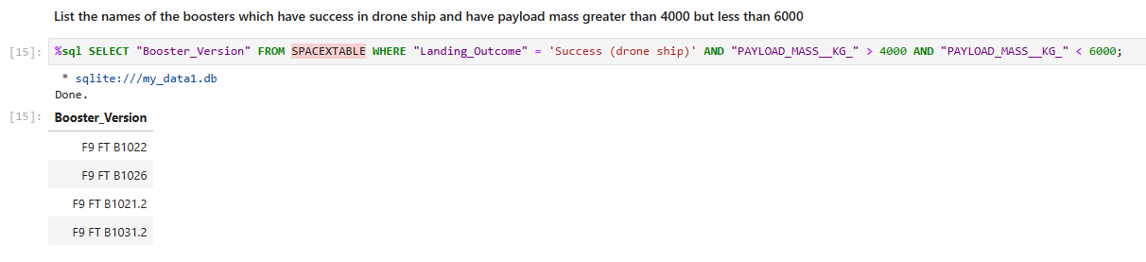
Successful Drone Ship Landing with Payload between 4000 and 6000
Boosters F9 FT B1022, F9 FT B1026, F9 FT B1021.2, and F9 FT B1031.2 achieved successful drone ship landings with payloads between 4000–6000 kg, showcasing reliable performance in this range.

Slide 30
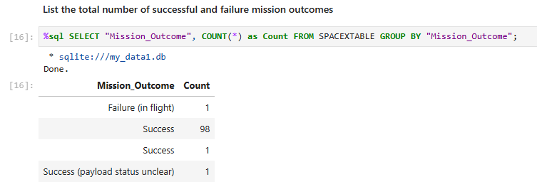
Total Number of Successful and Failure Mission Outcomes
The mission records show 98 clear successes, along with 1 in-flight failure, 1 success with unclear payload status, and 1 additional success entry, demonstrating a strong overall reliability.

Slide 31
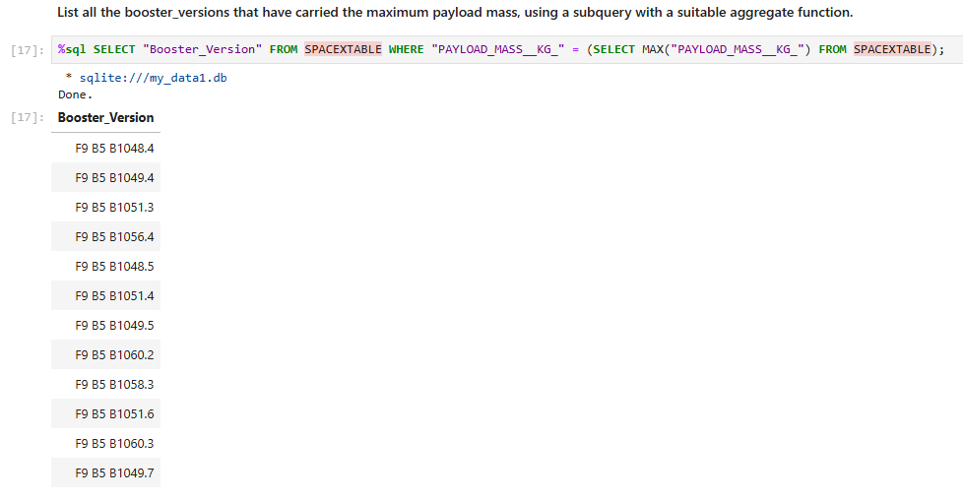
Boosters Carried Maximum Payload

Slide 32
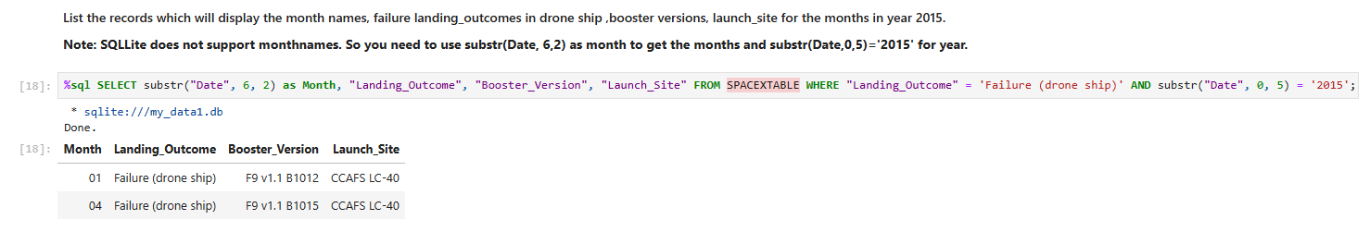
2015 Launch Records
In 2015, two drone ship landing failures occurred with F9 v1.1 B1012, one in January and another in April, both launched from CCAFS LC-40.

Slide 33
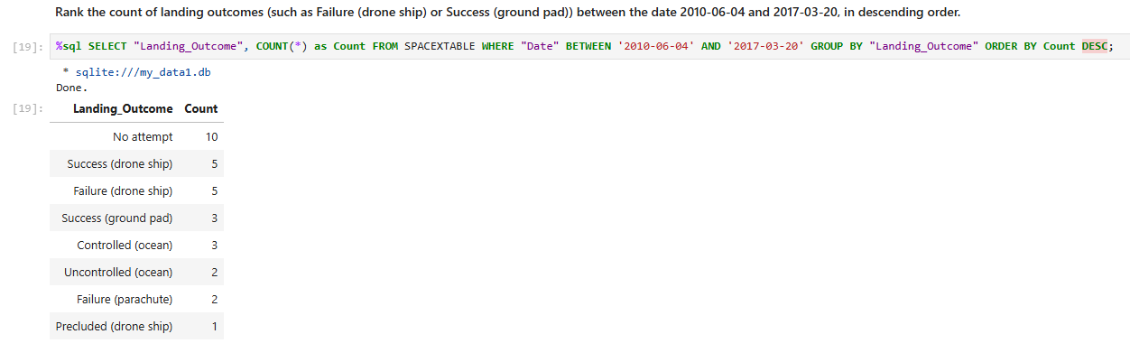
Rank Landing Outcomes Between 2010-06-04 and 2017-03-20

Slide 34

Section 3

Slide 35
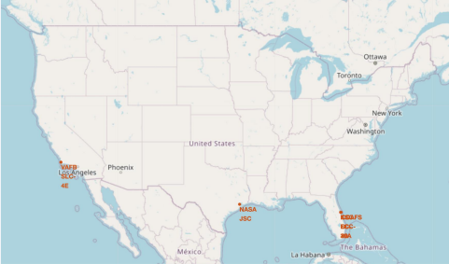
Launch Site Map
Geographic Distribution
SpaceX launch sites strategically located on coastal regions in Florida and California
Coastal positioning minimizes risk of catastrophic failures affecting populated inland areas
Proximity to ocean allows for safe trajectory paths and booster recovery operations
Key Observations
All major launch sites concentrated along United States coastlines
Florida sites provide optimal access to various orbital inclinations
California sites enable polar and sun-synchronous orbit missions
Safety Considerations
Coastal locations reduce risk to human activities during launch operations
Geographic isolation provides safety buffer zones for launch failures

Slide 36
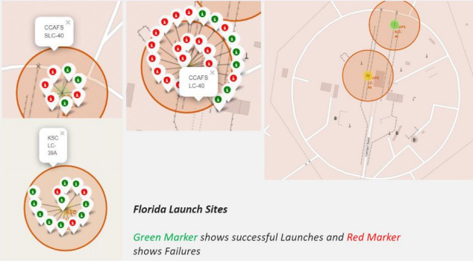
Launch success report
Visual Analysis System
Interactive map displays launch sites with color-coded markers indicating mission outcomes
Green markers represent successful launches while red markers indicate failures
Circular proximity zones highlight geographic clustering of launch activities
Site-Specific Patterns
Florida launch sites show mixed success/failure patterns with high launch frequency
California launch site demonstrates concentrated launch activity with distinct outcome distribution
Color clustering reveals performance trends across different geographic locations
Key Insights
Launch success rates vary significantly between different site locations
Geographic factors may influence mission outcome patterns
Site selection appears correlated with specific mission types and success probabilities

Slide 37
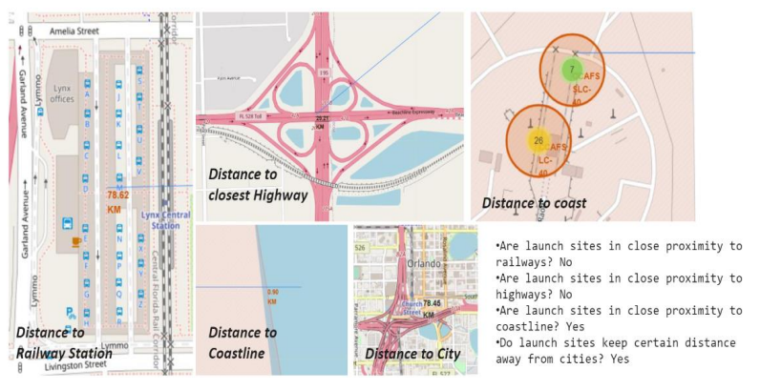
Distance from the Landmarks

Slide 38

Section 4

Slide 39
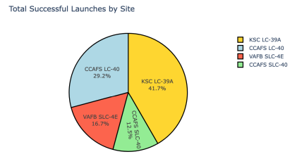
Overview of individual Launch Site’s Successful Landings
KSC LC-39A experienced the highest proportion of successful landings, followed by CCAFS LC-40.
• VAFB SLC-4E and CCAFS SLC-40 the lowest.

Slide 40
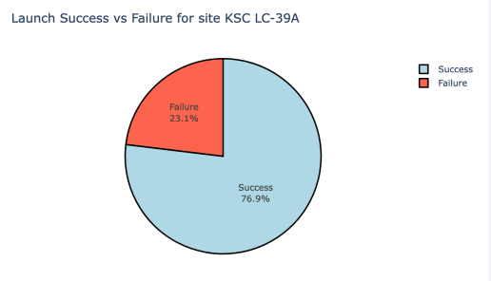
Every site’s Lunch success rate
Kennedy Space Center's LC-39A facility achieved approximately three-quarters success rate (76.9%) with nearly one-quarter failure rate (23.1%)

Slide 41
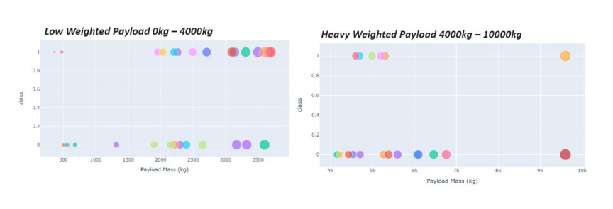
Payload vs Lunch Outcome
Launch success probability decreases as payload mass increases, with low-weight missions outperforming heavy-weight missions

Slide 42

Section 5

Slide 43
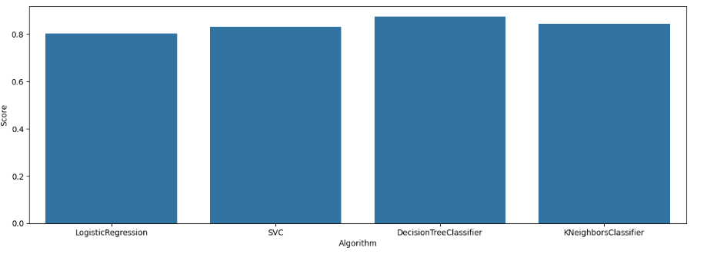
Classification Accuracy
Logistic Regression and KNN achieved the highest accuracy and recall, making them the top-performing models in this comparison.
SVC and Decision Tree performed slightly worse, showing lower recall and ROC-AUC values compared to the other models.

Slide 44
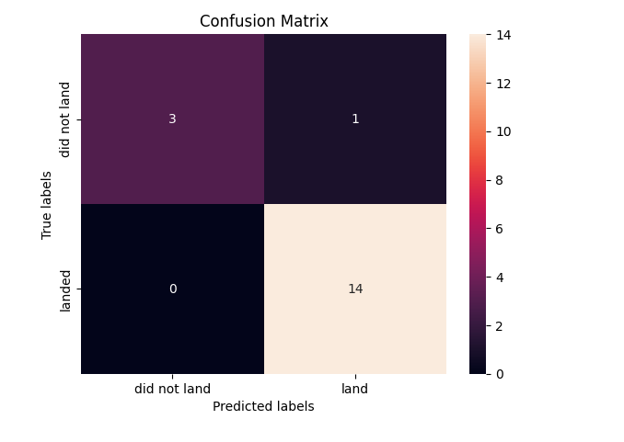
Confusion Matrix
The decision tree model shows excellent performance with 14 correct landings and only 1 misclassification.
It demonstrates high precision and recall, making it the best-performing model for this task.

Slide 45
Conclusions
Performance Trends
Success rates improved continuously over time
Higher launch frequency correlates with better performance
Key Findings
ES-L1, GEO, HEO, SSO, VLEO orbits show highest success rates
KSC LC-39A is top-performing launch site
Success rates increased markedly from 2013-2020
Machine Learning Results
DecisionTree Classifier achieved best prediction accuracy
Launch site is highly predictive factor for success
Multiple models demonstrated acceptable performance levels

Slide 46
Appendix
Data Sources
SpaceX API: Primary launch data collection endpoint
Wikipedia: List of Falcon 9 and Falcon Heavy launches (June 2021)
Processed datasets: Wrangled launch data with geographic coordinates
Interactive dashboard data: Filtered datasets for visualization components
Dataset Files
Raw data: dataset_part_1.csv
Cleaned data: dataset_part_2.csv
Geographic data: spacex_launch_geo.csv
Dashboard data: spacex_launch_dash.csv
GitHub Repository
Complete project available at: https://github.com/atahabilder1/IBM-Data-Science-Certificate

Slide 47


